Slide 1
rACI Matrix
What is a RACI Matrix?
Benefits of a RACI Matrix?
Should you implement a RACI Matrix for your project?

Slide 2
What is it?
The RACI matrix is used to clarify roles and responsibilities for each task, milestone and decision that takes place throughout a project. In practice, it’s a simple spreadsheet or table that lists all stakeholders on a project and their level involvement in each task, denoted with the letters R, A, C or I.
Responsible: The person or group responsible for completing a specific task or deliverable. They are responsible for doing the work.
Accountable: This role delegates, reviews, and ensure the project meets expectations and deadlines. This person responsible for the task’s success or failure. There should be only one "Accountable" person assigned to each task.
Consulted: Individuals or groups that need to be consulted for their expertise, input, or feedback during the task’s execution. These stakeholders are not directly responsible for the task but may offer valuable insights.
Inform: Individuals or groups that need to be informed about the progress or results of the task but don’t need to be actively involved in its execution.
*Source: Forbes, https://www.forbes.com/advisor/business/raci-chart/
Notes:
The RACI matrix is used to clarify roles and responsibilities for each task, milestone and decision that takes place throughout a project. In practice, it’s a simple spreadsheet or table that lists all stakeholders on a project and their level involvement in each task, denoted with the letters R, A, C or I.
Responsible: The person or group responsible for completing a specific task or deliverable. They are responsible for doing the work.
Accountable: This role delegates, reviews, and ensure the project meets expectations and deadlines. This person responsible for the task’s success or failure. There should be only one "Accountable" person assigned to each task.
Consulted: Individuals or groups that need to be consulted for their expertise, input, or feedback during the task’s execution. These stakeholders are not directly responsible for the task but may offer valuable insights.
Inform: Individuals or groups that need to be informed about the progress or results of the task but don’t need to be actively involved in its execution.

Slide 3
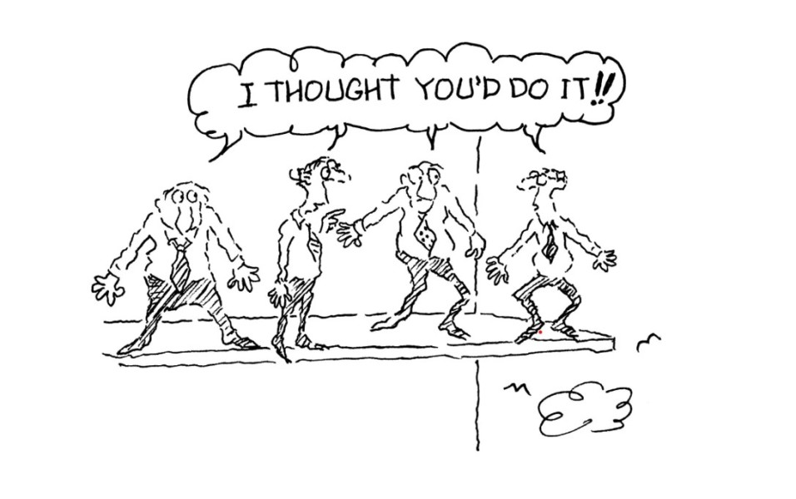
Benefits of a RACI Matrix?
Clarifies Roles & Responsibilities
Promotes Accountability
Facilitates Decision-Making
Reduces Conflict and Confusion
Notes:
The RACI Matrix
Clarifies Roles & Responsibilities
Promotes Accountability
Facilitates Decision-Making
Reduces Conflict and Confusion

Slide 4
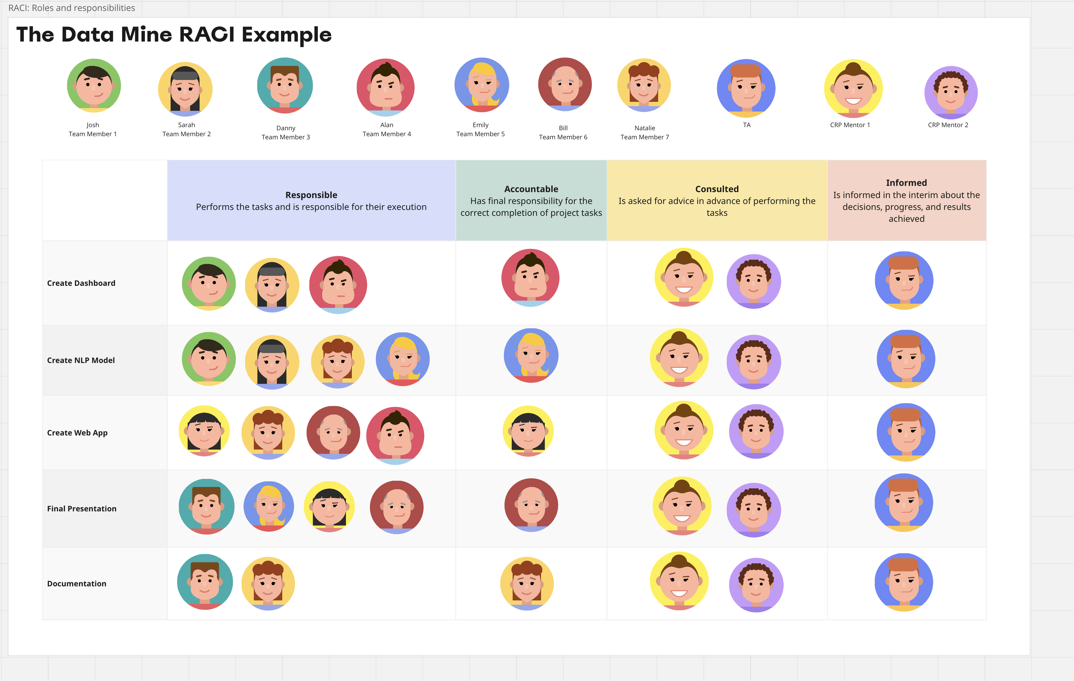
The Data Mine RACI Example
Notes:
The Data Mine RACI Example:
Your team was task with creating a webapp that utilizes NLP.
Incorporation
Creating a Dashboard
Josh, Sarah, and Alan are responsible for the developing the dashboard.
Alan is accountable for ensuring the dashboard is completed.
The Corporate Partner Mentors are consulted for advice of performing the task and the TA is informed.

Slide 5
Should you implement a RACI Matrix for your project?
Reflection and discussion…
Would your team benefit from having a RACI Board? Why or why not?
Notes:
Discussion on whether a RACI Matrix would be beneficial for the team.
* Every team is different so if your team believes a RACI Matrix can help clarify roles and responsibilities feel free to implement a RACI.

